Slide 1
AZ-300T02 M 3: Implementing Advanced Virtual Networking
Azure Load Balancer
Azure Application Gateway
Site-to-Site VPN Connections
ExpressRoute
Notes:
For Site-to-Site VPN create necessary assets before starting this module...

Slide 2
Lesson 1: Azure Load Balancer
Load Balancer
Public Load Balancer
Internal Load Balancer
Load Balancer SKUs
Backend Pool
Load Balancer Rules
Multiple Frontends
Multiple Frontends (Rule 2)
Session Persistence
Health Probes
Demonstration: Network Load Balancer
Practice: Standard Load Balancer
Practice: Internal Load Balancer
Practice: Load Balancer ARM Deployments

Slide 3
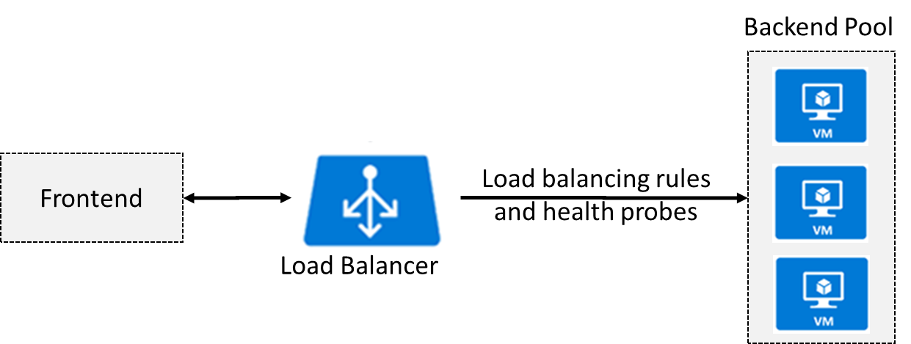
Load Balancer
Operates on OSI Layer 4 (TCP/UDP)
Relies on health probes to determine status of backend pool
Distributes traffic according to load balancing rules

Slide 4
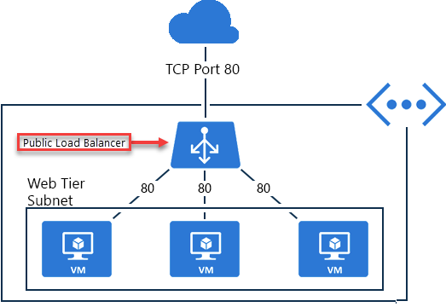
Public Load Balancer
Distributes traffic targeting a public IP address across backend VMs:
Frontend has one or more public IP addresses
Backend VMs have private IP addresses

Slide 5
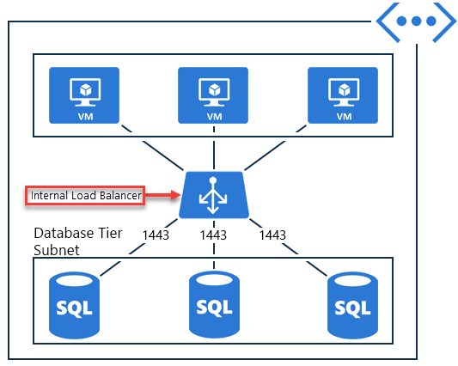
Internal Load Balancer
Distributes traffic targeting a private IP address across backend VMs:
Frontend has one or more private IP addresses
Backend VMs have private IP addresses
Supports load balancing:
Within a virtual network
For a cross-premises virtual network
For multi-tier applications
For line-of-business applications

Slide 6
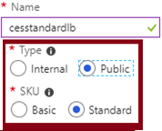
Load Balancer SKUs
Two SKUs:
Basic
Standard
Constraints and considerations:
SKUs are not mutable.
An Azure VM, Availability Set, or Azure VM Scale Set can reference one SKU, not both.
A Load Balancer rule cannot span two virtual networks.
There is no charge for the Basic load balancer.
The Standard load balancer is charged based on number of rules and data processed.

Slide 7
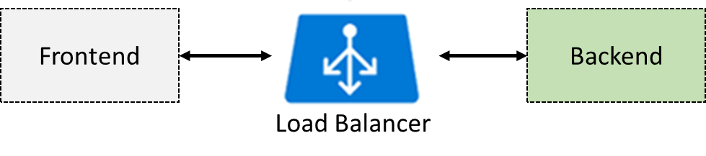
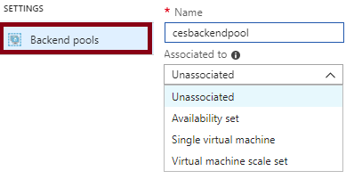
Backend Pool
Configuration depends on the load balancer SKU:
Standard:
Up to 1,000 Azure VMs in the same virtual network, including VMs in availability sets and VM scale sets.
Basic:
Up to 100 VMs in the same availability set or VM scale set.

Slide 8
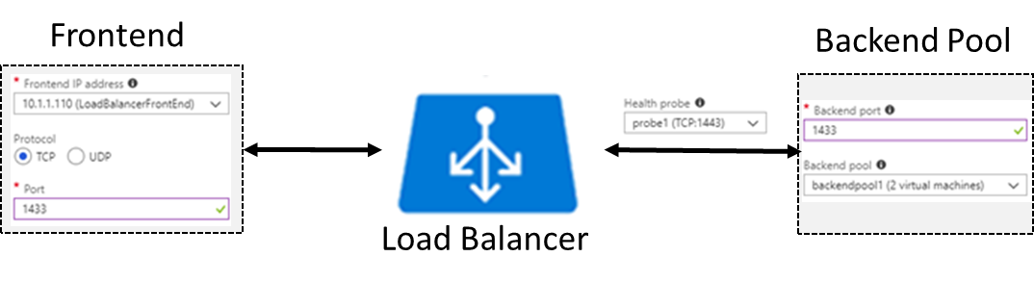
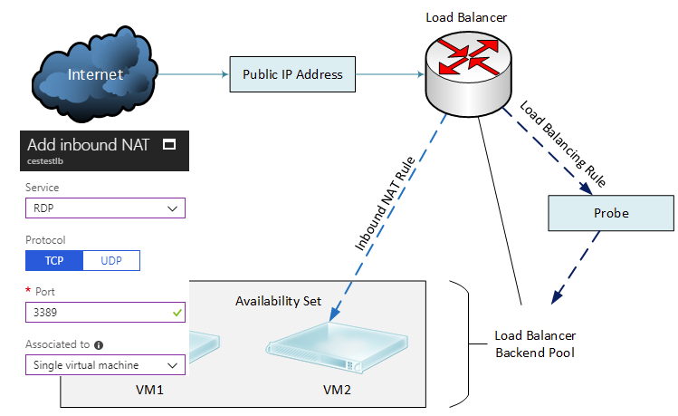
Load Balancer Rules
Determine traffic distribution
Require existing:
Frontend IP
Backend pool
Health probe
Can be used with NAT rules:
Allow connections to specific backend VMs

Slide 9
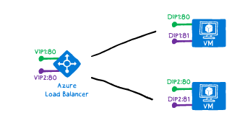
Multiple Frontends
Azure Load Balancer supports load balancing on:
Multiple IP addresses
Multiple ports
Multiple IP addresses and ports
Two types of rules map frontend and backend pool configurations:
1. The default rule with no backend port reuse
2. The floating IP rule where backend ports are reused
Rule type 1: No backend port reuse:
Frontends are configured with:
IP address, protocol, and port
Backend pool VMs expose each service on:
The same DIP and a unique port

Slide 10
Multiple Frontends (Rule 2)
Rule type 2: backend port reuse by using Floating IP
Requires enabling Floating IP in the rule definition:
Each backend pool VM has three network interfaces:
DIP. A Virtual NIC associated with the VM (IP configuration of Azure's NIC resource)
Frontend 1. A loopback interface within guest OS that is configured with IP address of Frontend 1
Frontend 2. A loopback interface within guest OS that is configured with IP address of Frontend 2
The destination of the inbound flow is the frontend IP address on the loopback interface in the VM.
By changing the destination IP address, you can enable port reuse on the same VM.

Slide 11
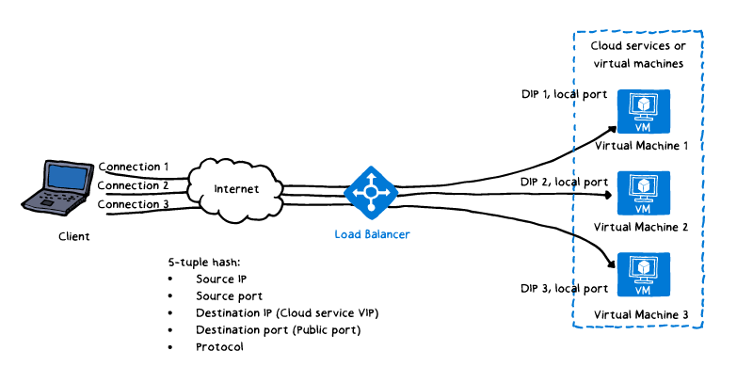
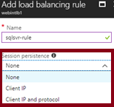
Session Persistence
Load balancing uses a hash to map traffic to backend pool VMs:
5-tuple (source IP, source port, destination IP, destination port, and protocol type)
Stickiness applies only within a transport session.
You can change the default session persistence (None) to:
Client IP
Client IP and protocol

Slide 12
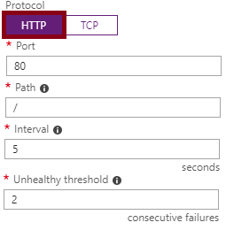
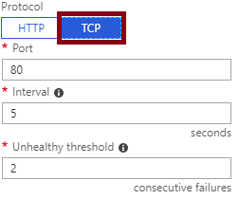
Health Probes
Evaluate status of load balanced workloads:
Unhealthy threshold set to 2 consecutive failures (default)
Interval set to 15 second (default)
Support two protocols:
HTTP:
Expects HTTP 200 OK response
TCP:
Tests for a successful TCP session

Slide 13
Lesson 2: Azure Application Gateway
Application Gateway Components
Web Application Firewall
Health Probes
Application Gateway Sizing
Path-Based Routing
Multiple Site Hosting
Secure Sockets Layer Offload
Redirection and Session Affinity
Demonstration: Configuring Application Gateway
Practice: Application Gateway
Practice: Web Application Firewall

Slide 14
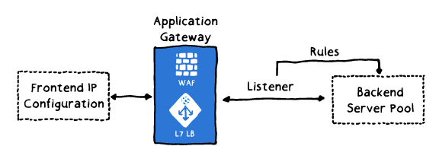
Application Gateway Components
Application Gateway is a load balancer operating on OSI Layer
Its components include:
Frontend IP configuration
Backend server pool
Listeners, including:
front-end port
protocol (HTTP or HTTPS)
SSL certificate (optional).
Rules
Web application firewall (WAF)

Slide 15
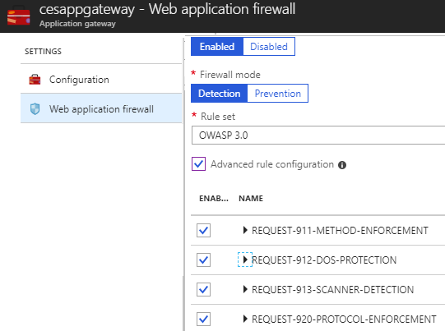
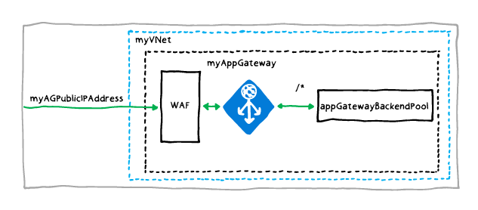
Web Application Firewall
Provides protection for backend server pool workloads:
Protects against common cyber threats (SQL injection, cross-side scripting, etc.)
Uses OWASP rules
Allows disabling rules that result in false positives

Slide 16
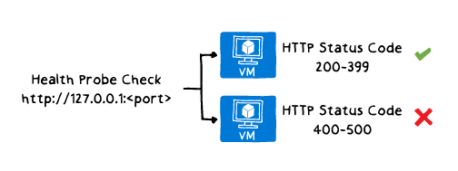
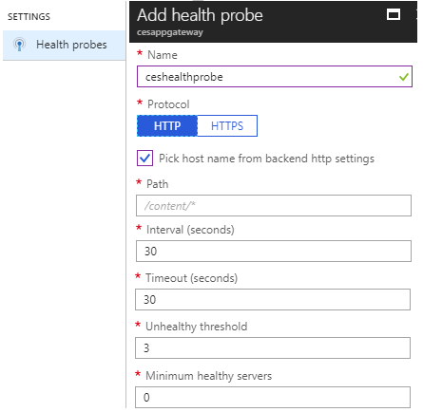
Health Probes
By default, health probes relies on healthy HTTP responses
Custom probes provide more control:
Facilitate more thorough health checks
Support custom values of:
Minimum healthy servers
Unhealthy threshold
Interval
Timeout
Path

Slide 17
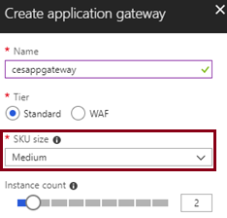
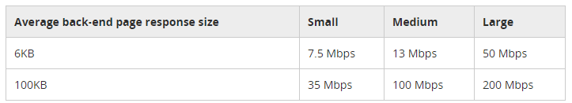
Application Gateway Sizing
Application Gateway is available in 3 SKUs:
Small: intended for development and testing only
Medium
Large

Slide 18
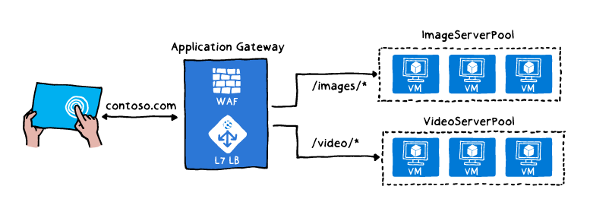
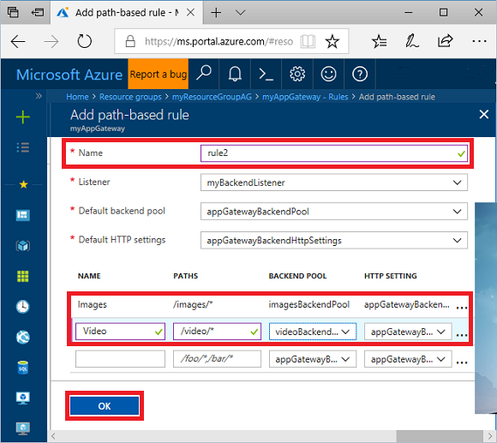
Path-Based Routing
Directs traffic based on target URL, e.g.:
/images to one backend pool
/video to another backend pool
To implement:
Specify the path pattern, e.g.:
/images/* and /video/*

Slide 19
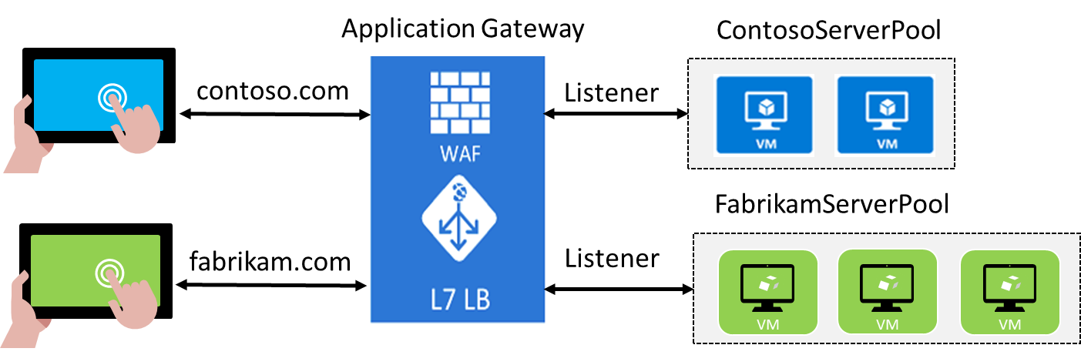
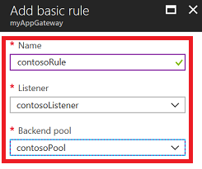
Multiple Site Hosting
Allows multiple web sites on the same Application Gateway instance:
Each with its own backend pool
Up to the total of 20 web sites
To implement:
Create 2 backend pools
Create 2 listeners
Create 2 routing rules
Arrange the rules in the intended order
Rules are processed in the order in which they are listed

Slide 20
Secure Sockets Layer Offload
Provides SSL termination at the gateway:
Eliminates performance impact of decryption on the backend pool VMs
Requires uploading certificate and binding it to the appropriate listener

Slide 21
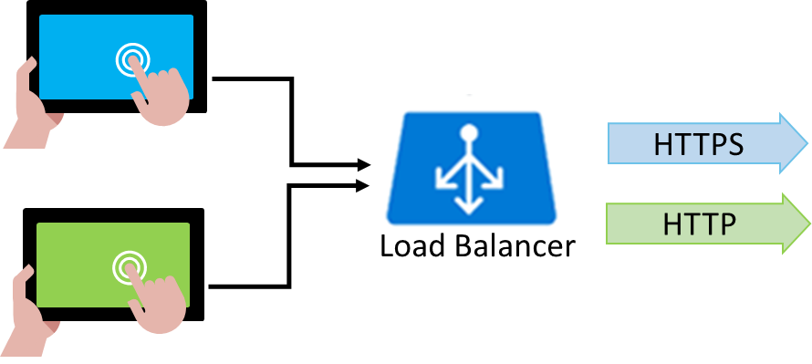
Redirection and Session Affinity
Redirection:
Protocol redirection:
Typically HTTP to HTTPS
Path-based redirection:
Apply protocol redirection for specific path only:
e.g. /cart/*
Redirection to external sites
Session affinity:
Cookie-based
Directs traffic to the same backend pool VM

Slide 22
Lesson 3: Site-to-Site VPN Connections
Video: Site-to-Site Connections
Site-to-Site VPN Connections
Site-to-Site Scenarios
Implementing Site-to-Site VPN
Gateway Subnet
VPN Gateway
Local Network Gateway
Configure the VPN Device
Configure the VPN Connection
Verify the VPN Connection
Demonstration: Site-to-Site VPN
Practice: Site-to-Site VPN Connections

Slide 23
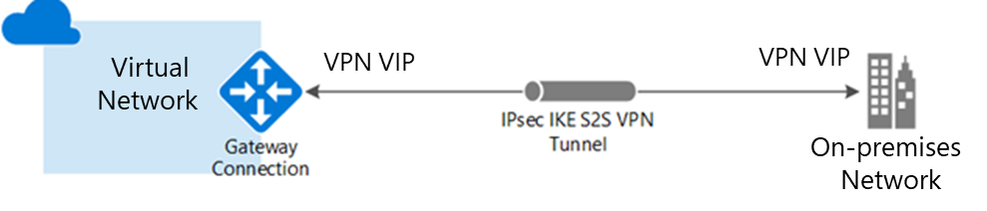
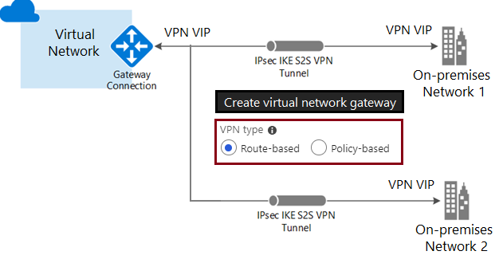
Site-to-Site VPN Connections
IPSec IKEv1 or IKEv2 VPN tunnels:
Cross-premises
VNet-to-VNet
Multi-site:
Requires a route-based VPN

Slide 24
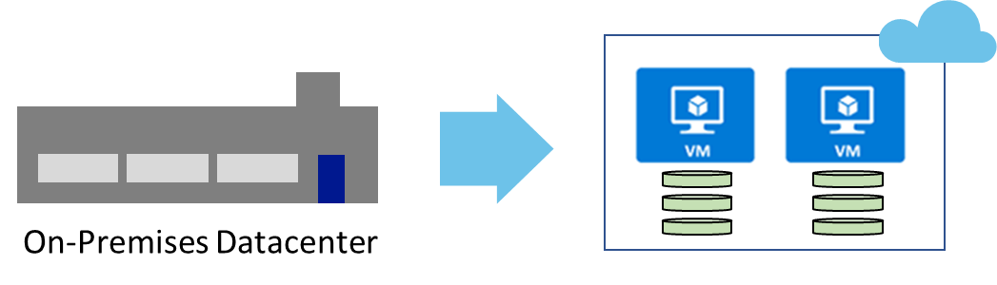
Site-to-Site Scenarios
Capacity On-Demand
Strategic Migration
Disaster Recovery

Slide 25
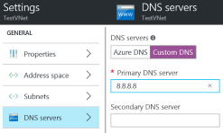
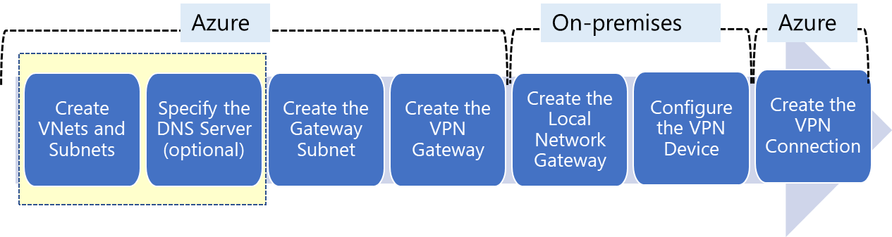
Implementing Site-to-Site VPN
1. Create VNets and subnets
2. Specify the DNS server (optional)
3. Create the Gateway subnet
4. Create the VPN Gateway
5. Create the Local Network Gateway
6. Configure the VPN device
7. Create the VPN Connection

Slide 26
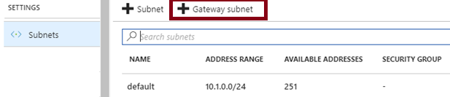
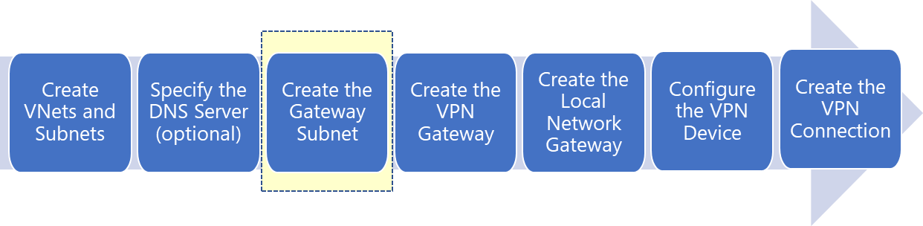
Gateway Subnet
Requires an IP range of /28 or larger
Must be named GatewaySubnet
Should not be associated to any Network Security Groups

Slide 27
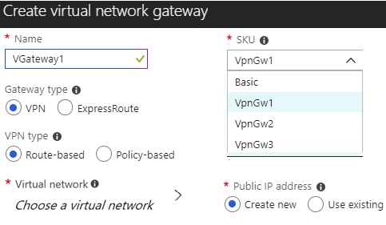
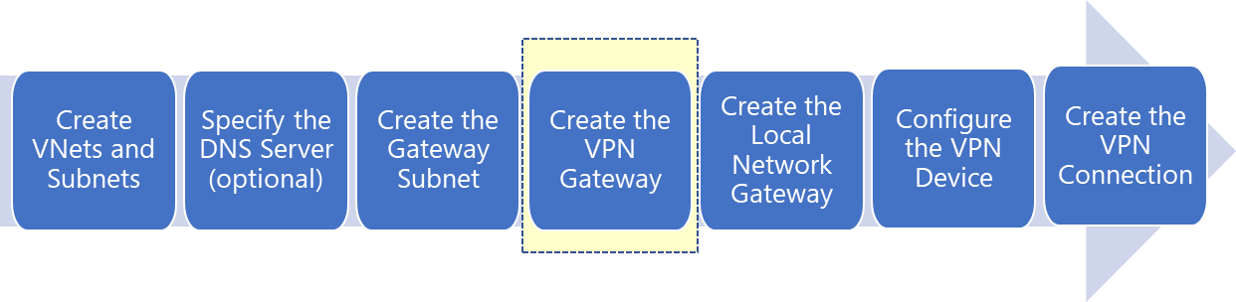
VPN Gateway
Establishes IPSec tunnel:
Handles traffic encryption
Supports multiple connections
One per GatewaySubnet
Supports two VPN types:
Route-based
Policy-based
Supports four SKUs
Basic, VpnGw1, VpnGw2, VpnGw3

Slide 28
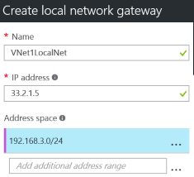
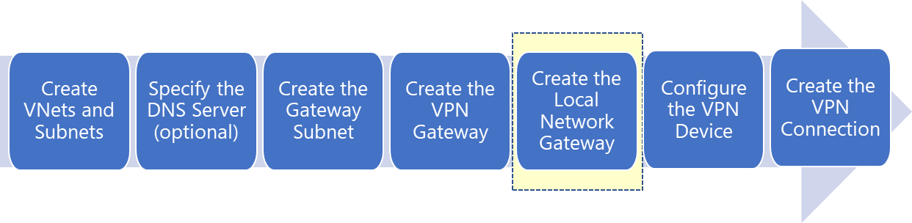
Local Network Gateway
In hybrid scenarios, represents on-premises VPN device
To configure, specify:
Name
IP address: the public IP address of the VPN device
Address space: one or more on-premises IP address ranges

Slide 29
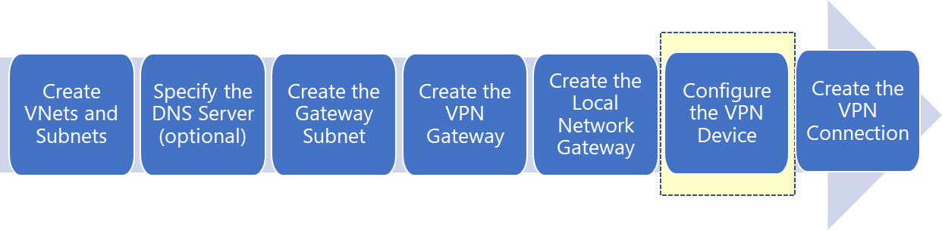
Configure the VPN Device
Follow instructions provided by Microsoft or device manufacturer:
Microsoft provides a list of the validated VPN devices
The configuration settings include:
A shared key
The public IP address of the VPN gateway

Slide 30
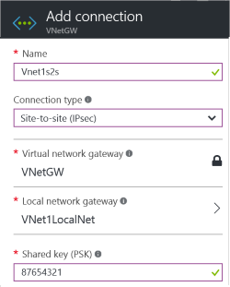

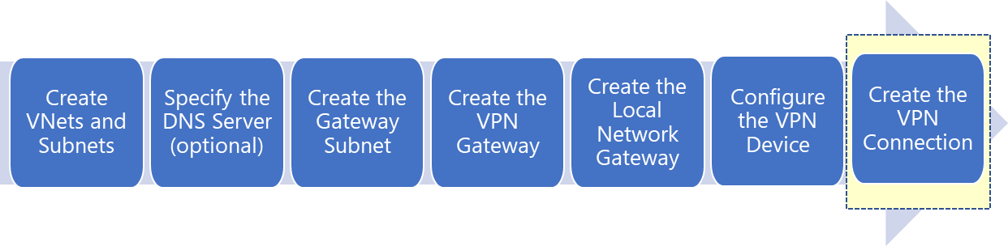
Configure the VPN Connection
Establishes IPSec tunnel between:
Azure VPN gateway
Local network gateway
Requires:
Shared key matching the one you used in the previous step

Slide 31
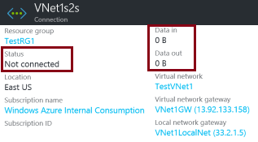

Verify the VPN Connection
The Azure portal:
Identify the connection status:
Connected
Succeeded
Note the Data in and Data out values
Azure Powershell:
Run the Get-AzureRmVirtualNetworkGatewayConnection cmdlet
Examine the values of:
connectionStatus
ingressBytesTransferred
egressBytesTransferred

Slide 32
Lesson 4: ExpressRoute
ExpressRoute
ExpressRoute Connection Options
Demonstration: ExpressRoute Circuits
Video: ExpressRoute Performance Monitoring
Site-to-Site and ExpressRoute Coexisting Connections
Practice: ExpressRoute and Site-to-Site Coexistence

Slide 33
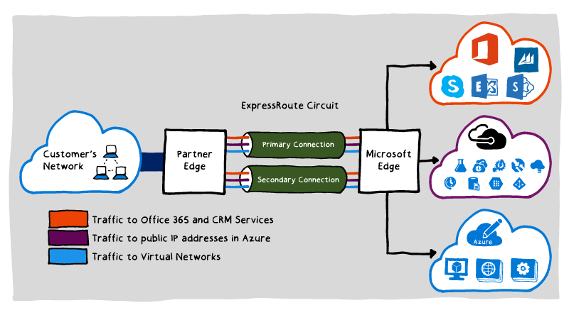
ExpressRoute
Private connection that extends on-premises network to:
Microsoft Azure
Office 365
Dynamics 365
Benefits:
Enhanced reliability
Higher bandwidth
Lower latency
Increased security
Common scenarios:
Data migration
Business continuity

Slide 34
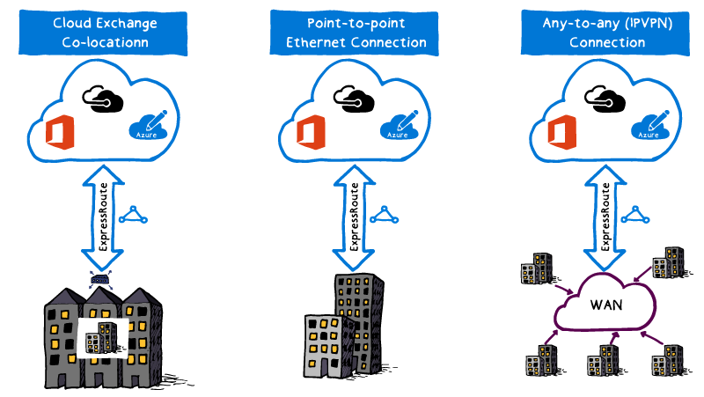
ExpressRoute Connection Options
Cloud Exchange Co-location
Point-to-point Ethernet Connection
Any-to-any (IPVPN) Connection

Slide 35
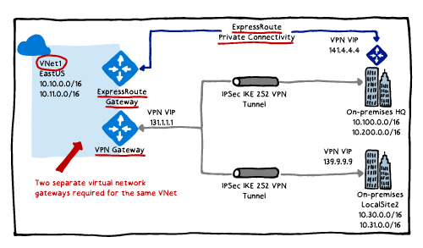
Site-to-Site and ExpressRoute Coexisting Connections
Configuration:
VPN gateway and ExpressRoute gateway are deployed to the same GatewaySubnet
Benefits:
Extended scope of connectivity
A cost effective failover

